Slide 1
TOPIC:-ANTI SLEEP ALARM
GUIDED BY:- SUBMITTED BY:-
SANIYA SINGH
ARYA WAGHELA
DHATRI
DARSHAN
RITIK

Slide 2
ABSTRACT:-
In modern-times, owing to hectic schedules it becomes very difficult to remain active all the time. Imagine a situation where a person is driving home from work, dead tired after facing all the challenges of the day. His hands are on the wheel and foot on the pedal but suddenly he starts feeling drowsy, his eyes start shutting and his vision blurs and before he knows it, he’s asleep. Falling asleep on the wheel can lead to serious consequences, there may be accidents and people may even lose their lives. This situation is much more common then we notice and hence, it is very important to counter this problem. So to address this issue, “We have come up with a Driver Anti-sleep Alarm.” This system alerts the user if he/she falls asleep at the wheel thereby, avoiding accidents and saving lives. This system is useful especially for people who travel long distances and people who are driving late at night.

Slide 3
Table of Contents:- 1. Introduction 1.1 Project motivation and purpose 1.2 Project functions 1.3 Hardware system overview/ block diagram
2. Conclusion 2.1 Accomplishments 2.2 Ethnics 2.3 Future work 2.4 Uncertainty
3. References
4.Appendix

Slide 4
1. Introduction 1.1. Project motivation and purpose- The goal of this project is to develop a system that can accurately detect sleepy driving and make alarms accordingly, which aims to prevent the drivers from drowsy driving and create a safer driving environment. The project was accomplished by ir sensor who constantly take a image of driver and when he or she accidently close his/her eyes ,a feedback circuit that could generate alarm and a power supply system.
Components Used:-
1)Relay
2) Piezo buzzer
3) Wires
4) 9v battery
5) Gear motor
6) Wheel
7) Arduino nano
8) SPST switch
9) Eye blink sensor

Slide 5
1.2.Functions and Features- This system has many features that make it unique and functional. These features include: 1. Eye extraction, use open and close to determine sleepiness 2. Daytime and night detection 3. Real time image processing and detection 4. Sound and flashing LED warning system to redraw driver’s attention 5. Little inference and potential hazard to driver’s normal driving 6. Portable size.

Slide 6
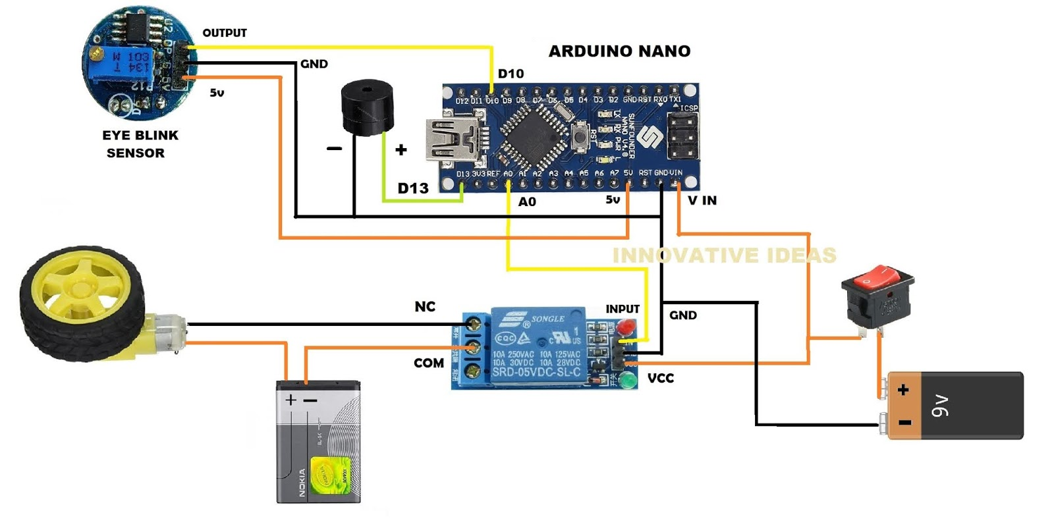
1.3 Hardware system overview/ block diagram-

Slide 7
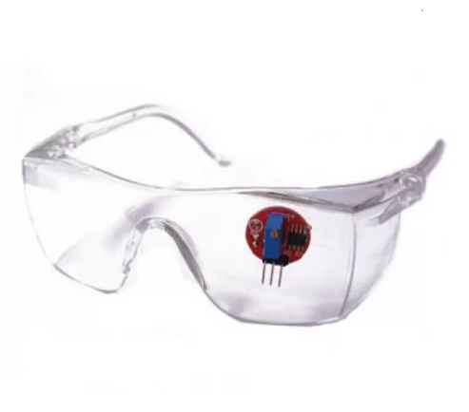
Eyeblink Sensor-
The eye blink sensor is an infrared sensor. It contains two parts. A transmitter and a receiver. The transmitter continuously emits infrared waves onto the eye. While the receiver continuously looks for variations in the reflected waves which indicates that the eye has blinked.
If the eye is closed that means it will give high output. If the eye is open then it will give a low output.
This sensor can be used in a very different variety of robotics and mechatronics projects as it provides excellent results and is very economical.

Slide 8
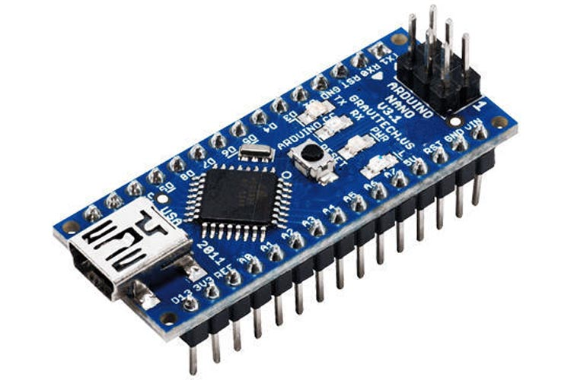
Arduino Nano-
The Arduino Nano is another popular Arduino development board very much similar to the Arduino UNO. They use the same Processor (Atmega328p) and hence they both can share the same program. here are total three ways by which you can power your Nano.
USB Jack: Connect the mini USB jack to a phone charger or computer through a cable and it will draw power required for the board to function
Vin Pin: The Vin pin can be supplied with an unregulated 6-12V to power the board. The on-board voltage regulator regulates it to +5V.
+5V Pin: If you have a regulated +5V supply then you can directly provide this o the +5V pin of the Arduino.

Slide 9
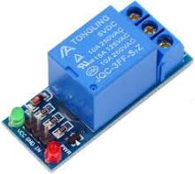
Relay Modules
A power relay module is an electrical switch that is operated by an electromagnet. The electromagnet is activated by a separate low-power signal from a micro controller. When activated, the electromagnet pulls to either open or close an electrical circuit. The relay module is an electrically operated switch that can be turned on or off deciding to let current flow through or not. They are designed to be controlled with low voltages like 3.3V like the ESP32, ESP8266, etc, or 5V like your Arduino. Relays are switches that open and close circuits electromechanically or electronically. Relays control one electrical circuit by opening and closing contacts in another circuit. As relay diagrams show, when a relay contact is normally open (NO), there is an open contact when the relay is not energized.

Slide 10
Conclusion- 2.1. Accomplishments As for the software part, we fulfilled our goal successfully. The detection algorithm could not only work effectively and accurately at daytime, but also at night. The Eye portion extraction is smooth and in real time with no delays on the computer. In addition, there is a bonus function in the software part – detection with glasses.
2.2 Ethnical consideration 1. to accept responsibility in making decisions consistent with the safety, health, and welfare of the public, and to disclose promptly factors that might endanger the public or the environment ; By using our Driver Sleep Detection and Alarming System, customers would be warned when his/her physical condition is not good enough for driving and thus prevents dangerous behaviors from happening. It is consistent with the safety and welfare of the public.
2.to improve the understanding of technology; its appropriate application, and potential consequences; 3.to help drivers achieve a better and safer driving condition. to seek, accept, and offer honest criticism of technical work, to acknowledge and correct errors, and to credit properly the contributions of others; We consult Professor and TAs for review advices and improve, seek online resources to help correcting errors, and properly cite the contributions of other people.
4.to avoid injuring others, their property, reputation, or employment by false or malicious action; We design our product using qualified components and follow proper safety rules.

Slide 11
2.3. Future work
1. Use OpenGL to control the frame rate more accurately 2. To achieve a higher accuracy at night 3. Use parallel programming such as CUDA to make code faster and more efficient 4. Use bash script to enable our program to auto start after booting. 5. Use parallel programming and multi thread to handle image capturing, sending control signal, and running algorithm separately. 6. Design hardware enclosure for PCB , microcontroller and USB battery 7. Use more advanced components in out/in capacitors to reduce the voltage.

